Slide 1
Number theory
Format
This lecture - now
Practice problems - available now (see description)
Stream - in ~2.5 days
General tip: model it as an equation (if possible)

Slide 2
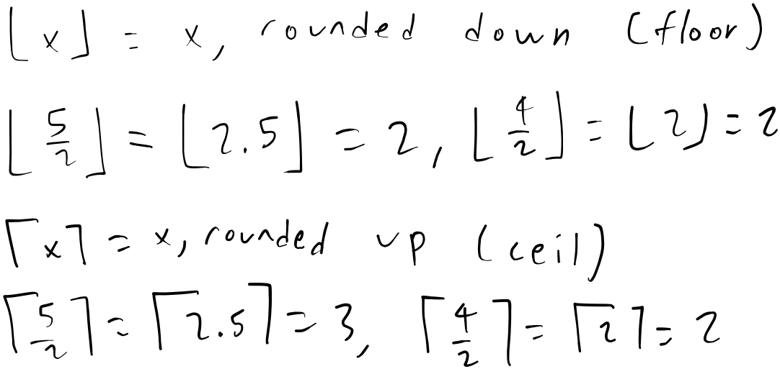
Floor/ceil

Slide 3
Divisors (basic definitions)
a | b <-> “a divides b” <-> “b is divisible by a” <-> b % a = 0
Divisor (or factor) of x: a number y where y | x
Transitive: a | b, b | c -> a | c
Prime: no divisors except 1 and itself
Prime factorization: breaking a number down into a product of primes (or prime powers: p^{k} for prime p and integer k)
ex: 2 = 2, 10 = 2 * 5, 254436 = 2² * 3 * 7 * 13 * 233
27 = 3 * 9 not valid, 9 can be further broken down, should be 27 = 3³

Slide 4
Prime factorization
Goal: break x down into its prime divisors
Naive - try all numbers up to x
A bit less naive - try only the primes up to x
Even less naive - you can’t have two primes larger than sqrt(x). So you only have to check up to sqrt(x), then you can conclude that x is prime if it has no other prime factors.
Complexity: O(sqrt(x) / log(x)) [note, O(log(sqrt(x))) = O(log(x))]
Expected to have O(x / log(x)) primes within [1, x]

Slide 5
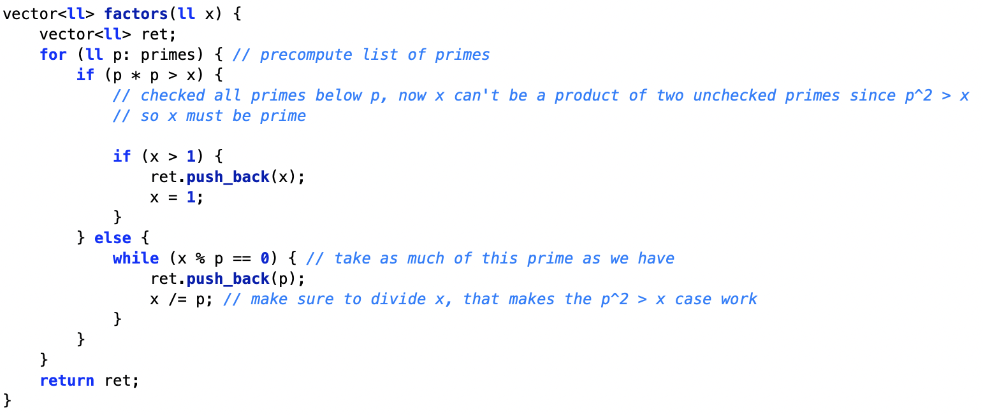
Prime factorization - code

Slide 6
More prime factorization
More algorithms, not covered here, with better complexities
See description for some of those algorithms
Also, see description for some wicked fast factorization code

Slide 7
Finding divisors
Similar to prime factors, but find all divisors of x
If you know y is a divisor, then x / y is too
Only have to check up to sqrt(x), the rest will be found as x / y
Complexity: O(sqrt(x))
Another algorithm: prime factorize x, then generate the divisors from that (DFS or something)
If implemented well, O(number of divisors)

Slide 8
Modulo
% - modulo
x % m is the remainder of division of x / m
ex: 17 / 6 = 2 with remainder 5, so 17 % 6 = 5
Math requires: 0 <= (x % m) < m
17 % 6 = (17 - 6 - 6) = 5, -15 % 6 = (-15 + 6 + 6 + 6) = 3
Another representation: x = am + b [a, b integers; 0 <= b < m]
17 = 2 * 6 + 5, -15 = -3 * 6 + 3
Since [am] is a multiple of m, we just drop it when modding
Since 0 <= b < m, it doesn’t change when modding
So (am + b) % m = b
In C++, -15 % 6 gives you -3, but it should be 3… be careful

Slide 9
Modulo - practice
Task: using the x = am + b representation, prove:
(a + b) % m = ((a % m) + (b % m)) % m
(a - b) % m = ((a % m) - (b % m)) % m
(a * b) % m = ((a % m) * (b % m)) % m
What about division? We’ll get to that soon...

Slide 10
Modulo - practice
(a * b) % m = ((a % m) * (b % m)) % m
Let a = cm + d, b = em + f
(a * b) % m
((cm + d) * (em + f)) % m
(cem² + cfm + dem + df) % m
Everything but df is a multiple of m, so we just get df % m
((a % m) * (b % m)) % m
(((cm + d) % m) * ((em + f) % m)) % m
(((d) % m) * ((f) % m)) % m
0 <= d < m, 0 <= f < m, so d % m = d, f % m = f
And we’re left with df % m again
(so, left side = right side)

Slide 11
More modulo
Binary exponentiation - compute a^{b} % m quickly
Write b in binary, ex: 21₁₀ = 10101₂
So a²¹ = a¹ * a⁴ * a¹⁶
a^{2x} = a^{x} * a^{x}, so we can compute a¹, a², a⁴, a⁸, etc. in O(1) each
Take modulo with each multiplication
Total complexity: O(log b)
What about something like a^(b^{c}) % m? b^{c} has to be computed modulo ϕ(m) - totient function, see description
Logarithm? Complicated, not covered here...

Slide 12
Modular division?
weird
Inverse of multiplication - modular multiplicative inverse
(1 / x) % m = x⁻¹ % m = the y such that xy % m = 1
Normally, x * (1 / x) = 1, so this works
2⁻¹ % 4 doesn’t exist? When does it?
Only exists if gcd(x, m) = 1 (we’ll get to gcd right after this)
Otherwise, any xy will be divisible by gcd(x, m) and can’t be 1

Slide 13
Modular division - computation
Want: y such that xy % m = 1
For prime m
Fermat’s little theorem: a^{m - 1} % m = 1 for any a, 0 < a < m (proof in description)
So divide both sides by a: a^{m - 2} = a⁻¹ (mod m)
That’s it, it’s just y = x^{m - 2}
For coprime x, m (gcd(x, m) = 1)
Extended euclidean algorithm, covered soon in this video

Slide 14
GCD
“Greatest common divisor”: gcd(x, y) = largest g where g | x, g | y
If x = p₁ªp₂^{b}... and y = p₁^{c}p₂^{d}..., then gcd(x, y) = p₁^{min(a, c)}p₂^{min(b, d)}...
Uses the Euclidean algorithm
gcd(a, b, c, …) = gcd(gcd(a, b), c, …)

Slide 15
Euclidean GCD
gcd(a, b) = gcd(a - b, b)
Let the GCD be g, then g | a and g | b, so a % g = 0, b % g = 0
(a - b) % g = ((a % g) - (b % g)) % g = 0, so g | (a - b)
Some casework to show g doesn’t increase
Mod is repeated subtraction, so… gcd(a, b) = gcd(a % b, b)
Generally assumed a >= b, so we use gcd(a, b) = gcd(b, a % b)
gcd(x, 0) = x, base case
If a >= b, a % b <= a / 2, halves each time
O(log(min(a, b)))
Two numbers x, y are coprime/relatively prime if gcd(x, y) = 1

Slide 16
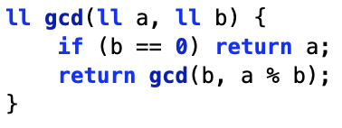
Euclidean GCD - example
gcd(133, 56) [133 = 7 * 19, 56 = 2³ * 7]
gcd(133, 56) = gcd(56, 133 % 56) = gcd(56, 21)
gcd(56, 21) = gcd(21, 56 % 21) = gcd(21, 14)
gcd(21, 14) = gcd(14, 21 % 14) = gcd(14, 7)
gcd(14, 7) = gcd(7, 14 % 7) = gcd(7, 0)
gcd(7, 0) = 7, so gcd(133, 56) = 7

Slide 17
Extended Euclidean algorithm
Solves: ax + by = 1 [a, b given; x, y unknown; gcd(a, b) = 1]
More generally: ax + by = gcd(a, b)
Bezout’s identity: says this solution (x, y) will always exist
More info in description, but basically run GCD backwards
So, want to solve for z: cz % m = 1
Run extended Euclidean with a = c, b = m, solving cx + my = 1
[my] factor lets you add and subtract m freely, just like mod
Alternatively, take both sides mod m, you get exactly cx % m = 1
Then, z = x
Also O(log(min(a, b)), same idea as GCD

Slide 18
LCM
“Least common multiple”: lcm(x, y) = smallest z where x | z, y | z
If x = p₁ªp₂^{b}... and y = p₁^{c}p₂^{d}..., then lcm(x, y) = p₁^{max(a, c)}p₂^{max(b, d)}...
lcm(a, b) = a * b / gcd(a, b)
lcm(a, b, c, …) = lcm(lcm(a, b), c, …)

Slide 19
Chinese remainder theorem
Given a, b, x, y [0 <= a < x; 0 <= b < y; x, y coprime]
Theorem states that there exists unique z where:
z % x = a
z % y = b
Not restricted to just 2 equations
If not coprime, can be invalid, impossible for z % 4 = 1, z % 6 = 0
How to find z?
Task: try to derive a way to find z, expected complexity better than O(x) or O(y)

Slide 20
Chinese remainder theorem - derivation
Hint 1: Remember the modulo form, x = am + b for b = x % m

Slide 21
Chinese remainder theorem - derivation
Hint 2: Reduce it to some algorithm (covered in this video) that runs in O(log(min(x, y)))

Slide 22
Chinese remainder theorem - derivation
Look at the case with only 2 equations - if there are more, do 2 at a time
Recall: task is to find z where
z % x = a
z % y = b
Let’s satisfy the first equation, so z = cx + a (for some integer c)
Plug that into second: (cx + a) % y = b
Subtract a: cx % y = (b - a) % y
We can solve for dx % y = 1 (since gcd(x, y) = 1), so let’s find d
Now, set c = (b - a) * d, which is thus equal to (b - a) [mod y]
Plug c into z = cx + a, and get z = d(b - a)x + a
Complexity: O(log(min(x, y)))

Slide 23
Möbius inversion (kinda?)
Ex: You have an array, length up to 10^5, array elements up to 10^5. Find the number of subsequences where the overall GCD of elements is 1. (problem link in description)
A modification: let all a[i] <= m, where m <= 10^5. For each x from 1 to m, find the number of subsequences where the overall GCD of elements is x

Slide 24
Möbius inversion (kinda?)
Ex: n = 5, m = 6, a = [2, 5, 3, 6, 1]
f(x) = answer for x
f(1) = 2⁵ - 1? but that counts stuff like {2, 6}
This really gives us g(x), which is f(x) over all multiples of x
So let’s get f(x) by subtracting out the multiples from g(x)
f(6) = g(6)
f(5) = g(5)
f(4) = g(4)
f(3) = g(3) - f(6)
f(2) = g(2) - f(4) - f(6)
f(1) = g(1) - f(2) - f(3) - f(4) - f(5) - f(6)
And that’s it.

Slide 25
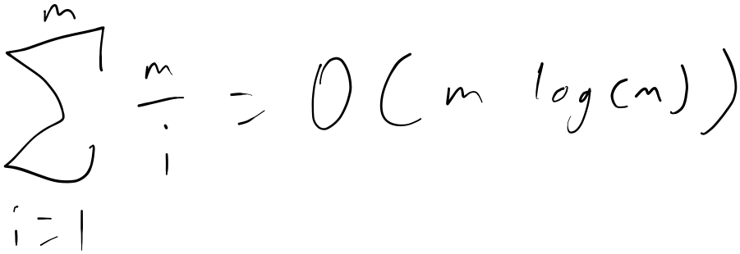
Subtracting multiples?
Can we just subtract out the multiples in less than O(n^2)?
Subtracting out multiples of i is O(m / i)
As it turns out,
(proof in description)
We also need to count the number of multiples of i for each i, but this can also be done in O(m / i) using a frequency array
So that’s the complexity - O(m log(m))

Slide 26
Conclusion
Do problems
Stream soon
Bye

Slide 27
